Slide 1
Algorithms
Summary and Interesting Cases from
COMP 5030 UMass Lowell
Chris Winsor 5/7/2021

Slide 2
Covered
Dynamic Programming and conversion from Recursive
Greedy Algorithms and Sub-structure Optimality
Amortized Analysis
Graph Algorithms
NP-completeness
String Matching
Specifically including:
Shortest path, Bellman-Ford, Difference equations, Maximum flow, Ford-Fulkerson, Dijykstra, Rabin-Karp, Finite state automata, Knuth-Morris-Pratt, Proving MP-Completeness by Reduction, Matrix-chain parenth-ization, Huffman code, Stack multi-Push, Dynamic Table, Dynamic Binary search, Maximum flow

Slide 3
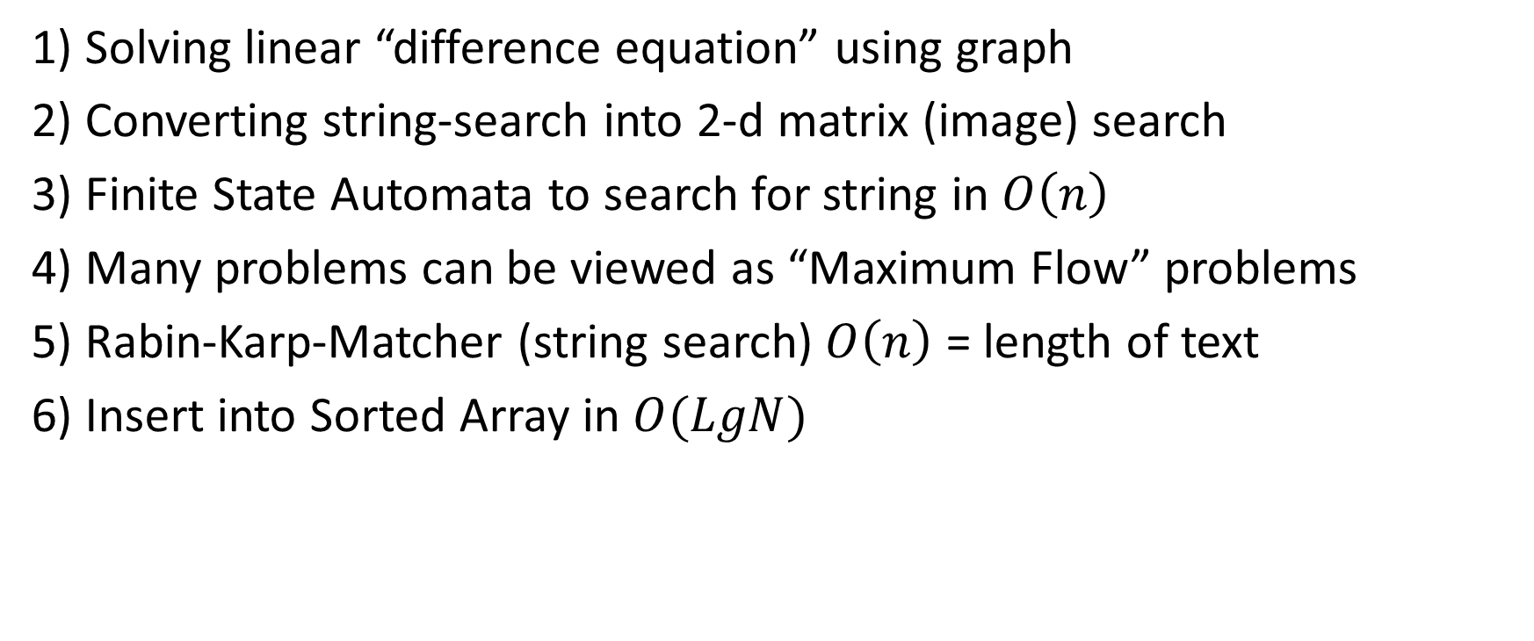
Interesting
1) Solving linear “difference equation” using graph
2) Converting string-search into 2-d matrix (image) search
3) Finite State Automata to search for string in $O\left(n\right)$
4) Many problems can be viewed as “Maximum Flow” problems
5) Rabin-Karp-Matcher (string search) $O\left(n\right)$ = length of text
6) Insert into Sorted Array in $O(LgN)$

Slide 4
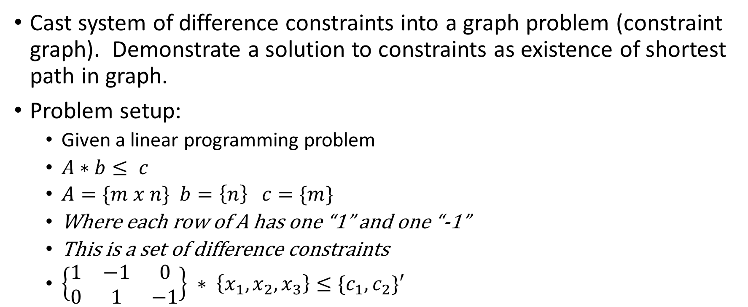
Interesting 1 Solving linear “difference equation” using graph
Cast system of difference constraints into a graph problem (constraint graph). Demonstrate a solution to constraints as existence of shortest path in graph.
Problem setup:
Given a linear programming problem
$A∗b≤ c$
$A=\{m x n\}$ $b=\left\{n\right\} c=\{m\}$
Where each row of A has one “1” and one “-1”
This is a set of difference constraints
$\left\{\begin{matrix}1 & −1 & 0 \\ 0 & 1 & −1\end{matrix}\right\} ∗ \left\{x_{1},x_{2}, x_{3}\right\}≤\{c_{1},c_{2}\}′$
Cormen, Leiserson, Rivest, Stein: 3rd Edition Page 664

Slide 5
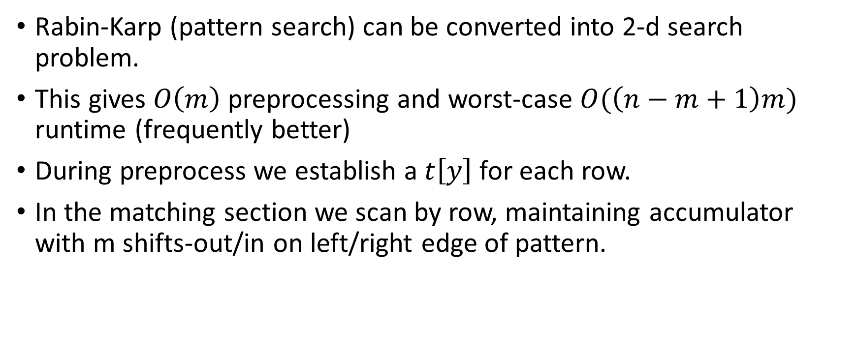
Interesting 2 Converting string-search into 2-d matrix (image) search
Rabin-Karp (pattern search) can be converted into 2-d search problem.
This gives $O\left(m\right)$ preprocessing and worst-case $O(\left(n−m+1\right)m)$ runtime (frequently better)
During preprocess we establish a $t\left[y\right]$ for each row.
In the matching section we scan by row, maintaining accumulator with m shifts-out/in on left/right edge of pattern.
Cormen, Leiserson, Rivest, Stein: 3rd Edition Page 990, Problem 32.3-3 (Hw6Pr4)

Slide 6
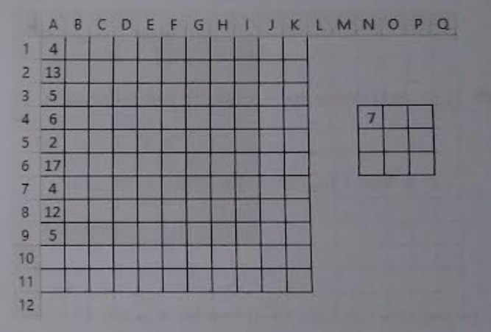
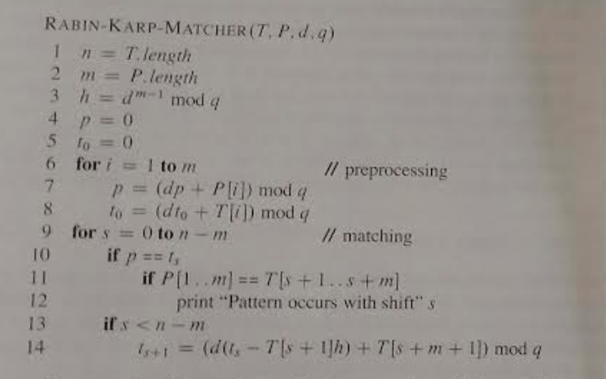
Interesting 2 (continued)
Cormen, Leiserson, Rivest, Stein: 3rd Edition Page 990, Problem 32.3-3 (Hw6Pr4)

Slide 7
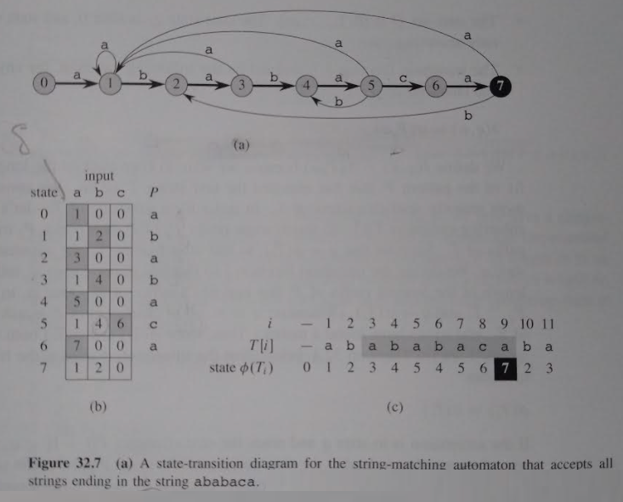
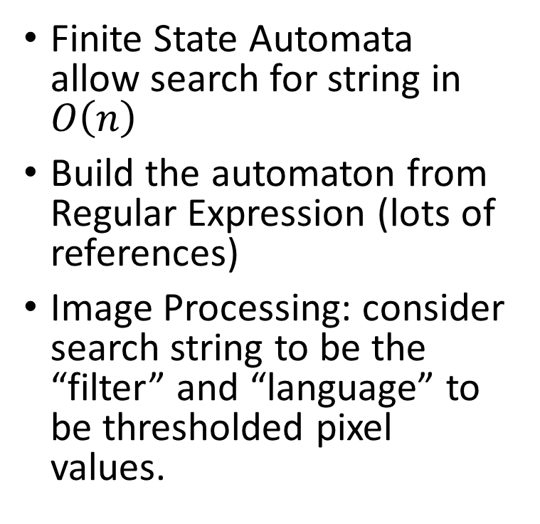
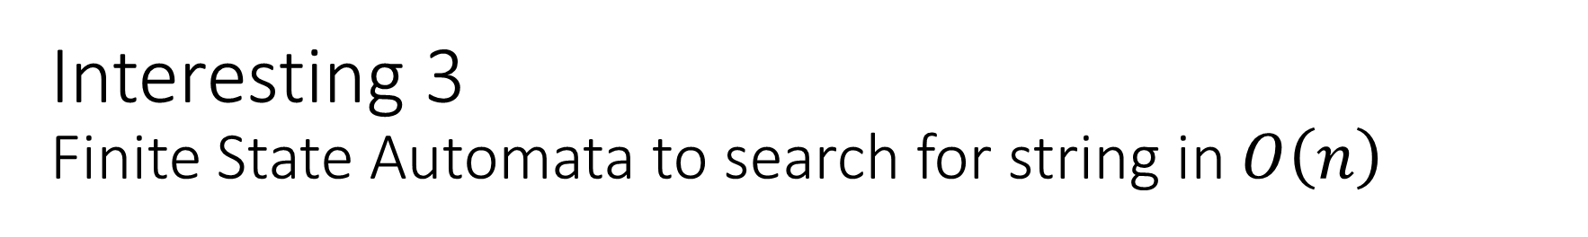
Interesting 3 Finite State Automata to search for string in $O\left(n\right)$
Finite State Automata allow search for string in $O\left(n\right)$
Build the automaton from Regular Expression (lots of references)
Image Processing: consider search string to be the “filter” and “language” to be thresholded pixel values.
Cormen, Leiserson, Rivest, Stein: 3rd Edition Page 995

Slide 8
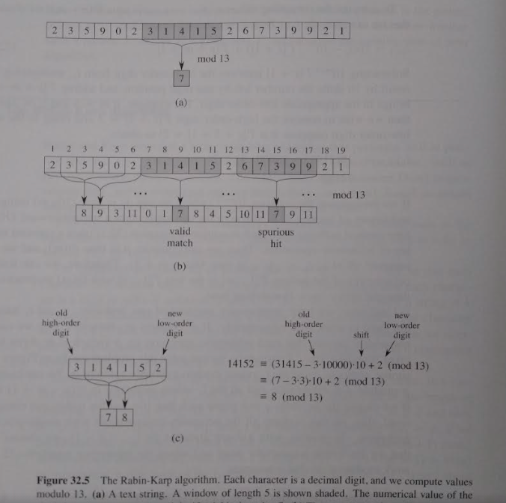
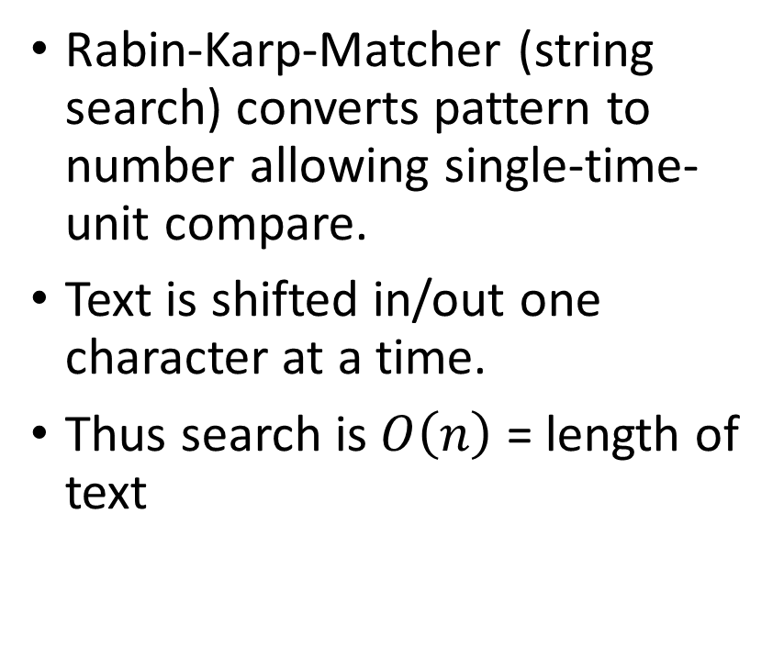
Interesting 5 Rabin-Karp-Matcher
Rabin-Karp-Matcher (string search) converts pattern to number allowing single-time-unit compare.
Text is shifted in/out one character at a time.
Thus search is $O\left(n\right)$ = length of text
Cormen, Leiserson, Rivest, Stein: 3rd Edition Page 992

Slide 9
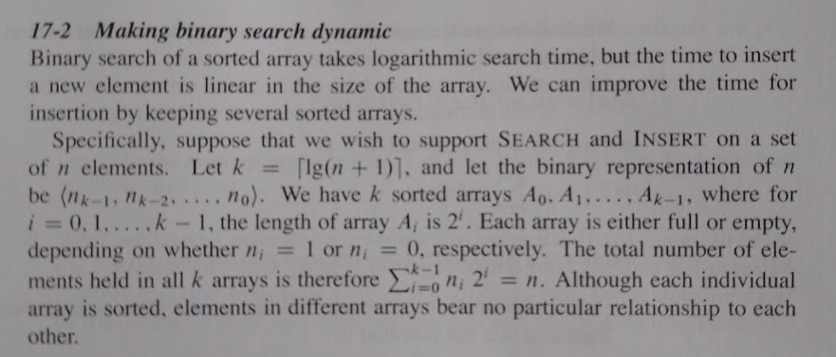
Interesting 6 Sorted array insert in O(Lg N)
Cormen, Leiserson, Rivest, Stein: 3rd Edition Page 473, Problem 17-2

Slide 10
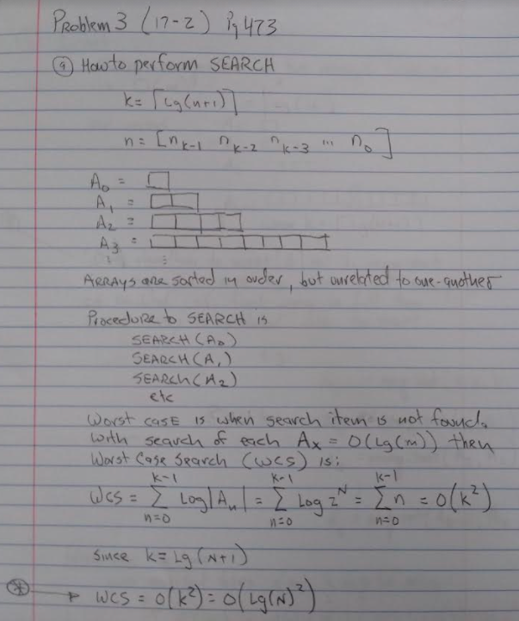
Interesting 6 (continued)

